Slide 1
Research Methodology- Unit 4 Measurement, Scaling and Sampling
Prime College- BIM 6th Semester

Slide 2
Research Methodology- Unit 4 Chapter 4- Validity and Reliability of measurement
Prime College- BIM 6th Semester

Slide 3


Learning Outcome
Validity and Reliability of measurement;
Sources of measurement problems;

Slide 4
Criteria of Good Measurement
Reliability
Validity, and
Sensitivity
Reliability, validity, and sensitivity are the prime elements to ensure the goodness of measurement. Reliability and validity ensure the truthfulness and credibility of research findings

Slide 5
Reliability
Reliability means dependability or consistency.
It suggests that the same thing will be repeated under identical or similar conditions.
This means if the measurement produces the same result at different times under the same or similar conditions, then the measurement is called reliability. Every researcher aims to reach scientific, acceptable, and accurate findings.
For this, scales applied in the research must be reliable.
Scale or measurement is said to be reliable when it produces consistent (almost the same) results if it is applied to the same sample again and again.
Major component of reliability: Consistency and Stable.
For Eg: Blood Pressure checked on same person and the result are:
1st reading: 120/80
2nd reading: 120/70
3rd Reading: 120/76
If the results were 150/100, 120/70 and 130/60, then the test would not be reliable as it is not consistent and vice versa.

Slide 6
Reliability
Kerlinger (1973) proposed the definition of reliability in three approaches.
The first approach concerns whether we get the same result repeatedly with the same measuring instrument in the same situation. This question implies a definition of reliability in terms of stability, dependability, and predictability.
The second approach concerns whether the result obtained from a measuring instrument is a 'true' measure of the property measured. This is an ‘accuracy’ definition.
The third approach concerns whether there is the absence of errors in a measuring instrument. This approach not only helps us for solving both theoretical and practical problems but also implies other approaches and definitions.

Slide 7
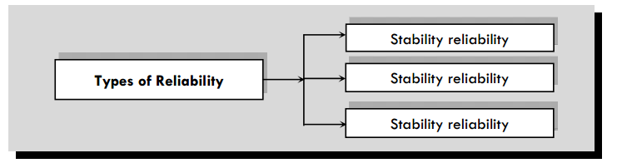
Types of Reliability
Representative Reliability
Equivalence Reliability

Slide 8
Types of Reliability
1. Stability reliability:
Stability reliability means the measure repeatedly gives the same or consistent result.
The reliability can be verified by adopting the test-retest method.
This stability answers the question: Does the indicator produce the same answer when applied at different times?
2. Representative reliability:
If the measurement produces the same or similar result from different groups, then the measurement is called representative reliability.
It addresses the question: Does the indicator produce the same result when applied to other groups?
3. Equivalence reliability:
Equivalence reliability is achieved if different measures give the same result.
If different indicators measure the same construct, then a reliable measure gives the same result with all indicators.
Split-half method of testing reliability is used to test equivalence reliability. It addresses the question: Does the measure yield consistent results across different indicators?

Slide 9
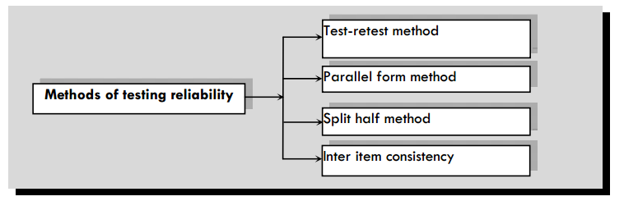
Methods of Testing Reliability

Slide 10
Methods of Testing Reliability
Test-retest method/ Stability Method:
Performing a test on the group of people at one time, performing the same test on the same group of people again on later time, then looking at test-retest co-relation between the two sets of scores.
If the measurement results are equal or almost equal then, it shows the research instrument/method is reliable and vice-versa.
This is done in those are where the result does not change frequently.
For Eg: intelligence of people while mood change cannot be tested through this method.
The test-retest method has two limitations.
 An individual tested on the first occasion may influence the measurement on subsequent tests. For instance, the individual may remember specific questions and respond the same way as the first time. This yields a high correlation but over-estimated reliability.
 Changes may occur during the interval of measurement. If so, there may be a change in response the second time, which increases the chances of decreasing the reliability estimate.

Slide 11
Methods of Testing Reliability
Alternative or Parallel form reliability test:
Under this method, Alternative or parallel, i.e., two comparable sets of measures are used for the same sample.
Both sets contain similar items with different wording or sequences of questions. If the same or almost similar results are revealed from both instruments, then the measurement is called reliable.
Unlike the test-retest method in parallel form test, both of the sets are administered almost at the same time so that there is no chance of the influence of time, as well as environment instability.
The major limitation of this method is that it is challenging to develop two sets of consistent measurement instruments for specific phenomena
For Eg: In educational assessment, it is often necessary to create different versions of tests to ensure that students don’t have access to the questions in advance. Parallel forms reliability means that, if the same students take two different versions of a reading comprehension test, they should get similar results in both tests.

Slide 12
Methods of Testing Reliability
Split-Half reliability test:
Split-half reliability test is a method of determining internal consistency.
In this approach, total items or indicators of the same construct are divided into two halves, like an odd number in one half and an even number in another half, hence sometimes called the odd and even method.
Then, the similarity measure, i.e., correlation coefficient, is computed.
Reliability is tested based on the stability and equivalency of the evidence.

Slide 13
Methods of Testing Reliability
Inter-item consistency reliability test:
It is another proper method of testing internal consistency.
This is a test of the consistency of respondent's answers to all the items in a measure.
The most popular test of inter-item consistency reliability is Cronbach's Alpha coefficient, a particular statistical measure.
For Eg: In boxing, there are three judges which provides their judgment. If the judgment by all three judges are similar then the judgment is reliable and vice-versa. Thus, the judges consult and then determine the winner. Another example: 12 Angry Men.
Notes:
https://www.youtube.com/watch?v=UxMxgW4LIms

Slide 14
Validity
Validity of measurement indicates how well the developed instrument measures the
particular concept it intends to measure.
This means validity is ensuring of measuring the thing which was aimed to measure according to theory.
This means validity concerns whether we measure the right concept or not.
Thus, validity deals with systematic errors. It suggests truthfulness.
The absence of validity occurs if there is a poor fit between the theoretical base and the actual situation in a social setting.
In simple terms, validity becomes poor if the measurement instrument does not cover all the aspects of the theory.
For Eg: thermometer is designed to measure body temperature not to check blood pressure.

Slide 15
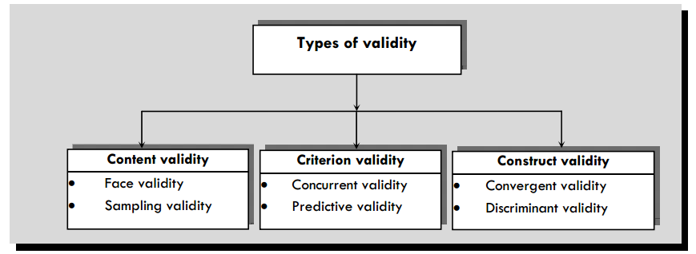
Types of Validity

Slide 16
Types of Validity
Content validity:
Content validity ensures that the measure includes an adequate and representative set of items that measure the concept. Hence, content validity measures the representativeness or sampling adequacy of the content of a measuring instrument. Content validity addresses the question:
Is the full content of a definition represented in a measure?
For Eg: A researcher aims to measure English language ability test of college students. Researcher develops a test which conatins reading, writing and speaking components but no listening component. As listening is an important aspect of language test, thus the test lacks content validity.
 Content validity can be of two types:
face validity: measures whether the indicators or items make sense as a measure of a construct understood by others.
Sampling validity: whether the measuring instrument adequately samples a given population of situations or behavior.

Slide 17
Types of Validity
Criterion-related or Predictive validity:
Criterion-related validity indicates the criterion to indicate a construct accurately.
It refers to the ability or success of measures to predict or estimate the relationship.
This ensures the predictive power of the measure. Instruments used to select employees should predict the behavior, skill efficiency, leadership quality, etc., so the right candidate can be selected.
For Eg: A researcher wants to know whether a college entrance exam is able to predict future academic performance of newly enrolled students. If the GPA score matches or be similar with admission test score then the admission exam has criterion validity. Then, 1st semester GPA can serve as the criterion variable, as it is an accepted measure of academic performance.
There are two types of criterion-related validity: Concurrent Validity and Predictive Validity
Notes:
https://www.youtube.com/watch?v=GyW2FYhyBLI

Slide 18
Types of Validity
Concurrent validity:
Used when the scores of the test and the criterion variables are obtain at the same time.
Score of the new test correlates with another test that is already considered as valid.
For Eg: If the score of one test is compared with the score of another test in same time and the score are similar and have correlation then it shows concurrent validity and vice versa.

Slide 19
Types of Validity
Predictive validity:
Used when the criterion variables are measured after the scores of the test.
For Eg: If a researcher examines how the results of job recruitment test can be used to predict future performance. If the candidate score a good marks in job recruitment test researcher predict that the candidate have a good future.

Slide 20
Types of Validity
Construct validity:
Construct is a theoretical concept or idea that’s usually not directly measureable.
For Example: Self-esteem, motivation, anxiety etc.
Construct Validity concerns the extent to which your test or measure accurately assess what it’s supposed to.
Convergent Validity: The extent to which measures of the same/similar constructs actually correspond to each other. For EG: if we are measuring two similar construct having same nature it must have positive correlation. Thus, the test should be similar.
Discriminant Validity: Two measures of unrelated constructs (e.g: anxiety and self-esteem) that should be unrelated, very weakly related or negatively related actually in practice. For EG: If two construct are different in nature then they should be tested differently rather than using same measurement. If anxiety and self-esteem are different then the test should be different. Researcher should not add self-esteem questions in anxiety question paper.

Slide 21
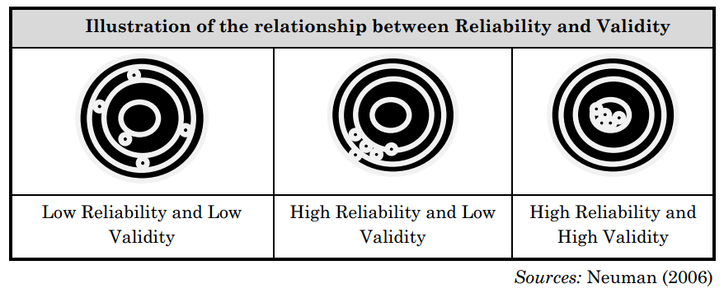
Relationship between Reliability and Validity
Notes:
High reliability but low validity:The indicators measure something
consistently, not the intended concept.
 High validity but low reliability:The indicator represents the concept well
but does not produce consistent measurements.
 Low validity and low reliability:In the worst case, the indicators neither
measure the concept nor produce consistent results of whether they measure.
 High validity and high reliability:We hope that the indicators consistently
measure what they intended to measure.

Slide 22
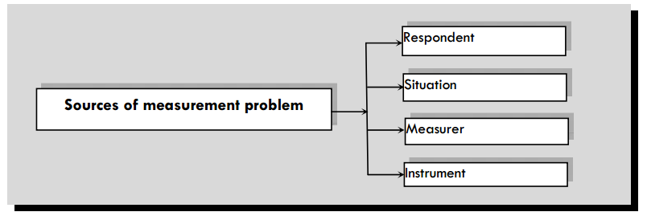
Sources of Measurement Problem

Slide 23
Sources of Measurement Problem
Respondent:
In many cases, respondents may be reluctant to express real feelings towards the statement.
They may have very little knowledge; they provide the information only at big guess.
Research must rely fully on the information supplied by respondents.
Result gets affected with wrong information caused by ignorance, anxiety, boredom, pressure, fatigue, irresponsibility, etc. of the respondent.
2. Situation:
Situational factors may also adversely affect the measurement process and accuracy.
For instance, if a third person is present during the interview or responding to a questionnaire.
Respondents can provide false or distorted responses according to the situation.
Respondents feel uncomfortable if they are not sure about keeping their response secret.
They may have a fear of their supervisors or managers, because of which they do not respond correctly.

Slide 24
Sources of Measurement Problem
3. Measurer:
The interviewer can distort responses by rewording or reordering questions.
His behavior, style, and looks may encourage or discourage specific replies from respondents.
Careless mechanical processing may distort the findings.
Errors may also creep in because of incorrect coding, faulty tabulation, and/or statistical calculations, particularly in the data analysis stage.
4. Instrument:
Error may arise because of the defective measuring instrument.
The use of complex words beyond the comprehension of the respondent, ambiguous meanings, poor printing, inadequate space for replies, response choice omissions, etc., are a few reasons that make the measuring instrument defective.
Instrument deficiency can be because of poor sampling as well.

Slide 25
Ranking Scale
Pair comparison scale:
This is a comparative scaling technique in which respondents are provided two alternatives for each object.
They are asked to select one object (rate between two objects at a time) according to some criterion from given two objects.
Data obtained from the paired comparison method are ordinal.

Slide 26
End of Chapter 4
(Click the arrow when in Slide Show mode)
Notes:
In Slide Show mode, click the arrow to enter the PowerPoint Getting Started Center.

